Slide 1
Following Covid-19 Cases in Chicago
Project 2
“GIT YOUR POPCORN READY”
Anu Guha, Yalu Zhou,
Korbin Mays, & Alejandro Coronel

Slide 2
Approach
Goals:
Build upon Project 1 - https://github.com/iunupe/project1/blob/master/Midwest.ipynb
Incorporate additional programming languages and interactive functionality to produce a hands-on, useful prototype
Collaboration:
Slack and Zoom web meetings
Anu →
Yalu →
Korbin →
Alejandro →
Project Manager | Python/Flask | Data Munging | Postgres SQL | RESTful APIs
GitHub Master | Plotly | Charts | D3 | JS
Presentation | CSS 3 | Font Awesome | Bootstrap 4 | HTML 5
Heroku | Leaflet | Heatmaps | GeoJSON | MapBox

Slide 3
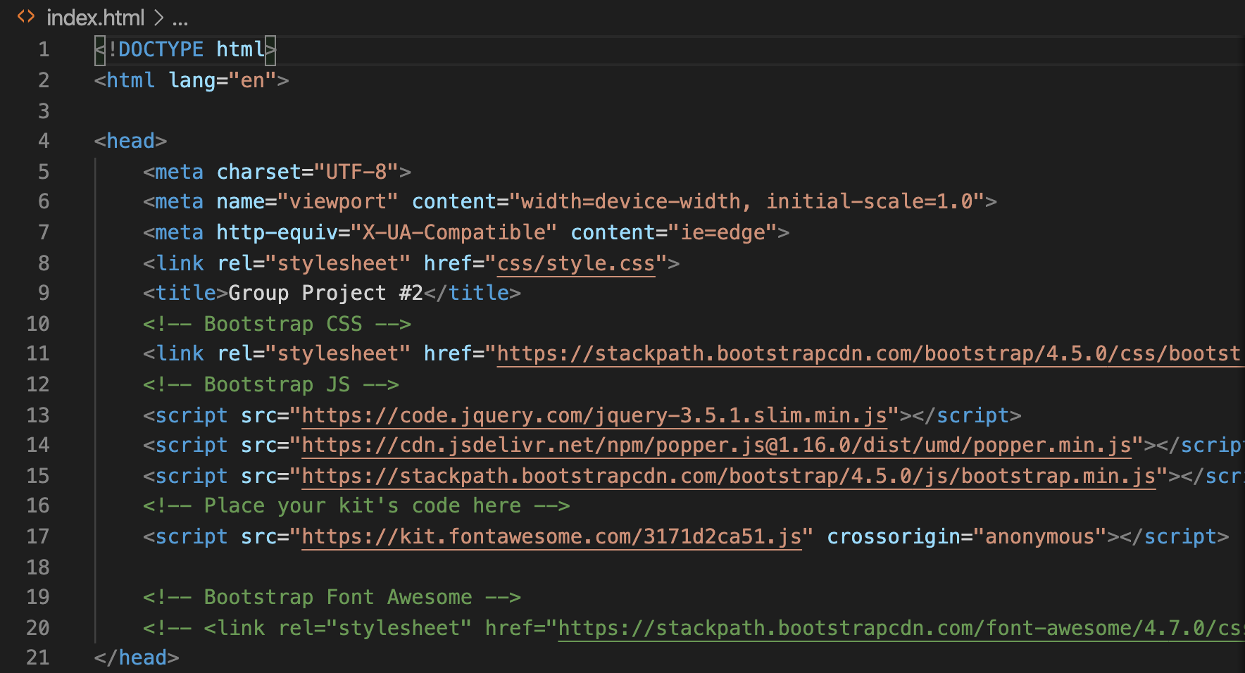
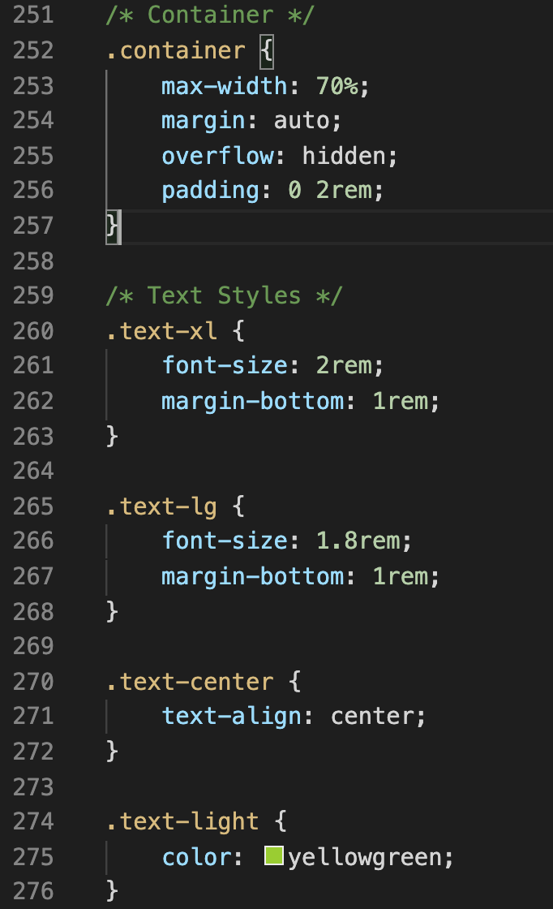
HTML/CSS Walk-Through
* Started with a basic Bootstrap HTML template, using some built-in HTML Emmet skeletons in VS Code
* Used different libraries to add formatting and style, using CSS and Font Awesome to build a working shell for everyone to use

Slide 4
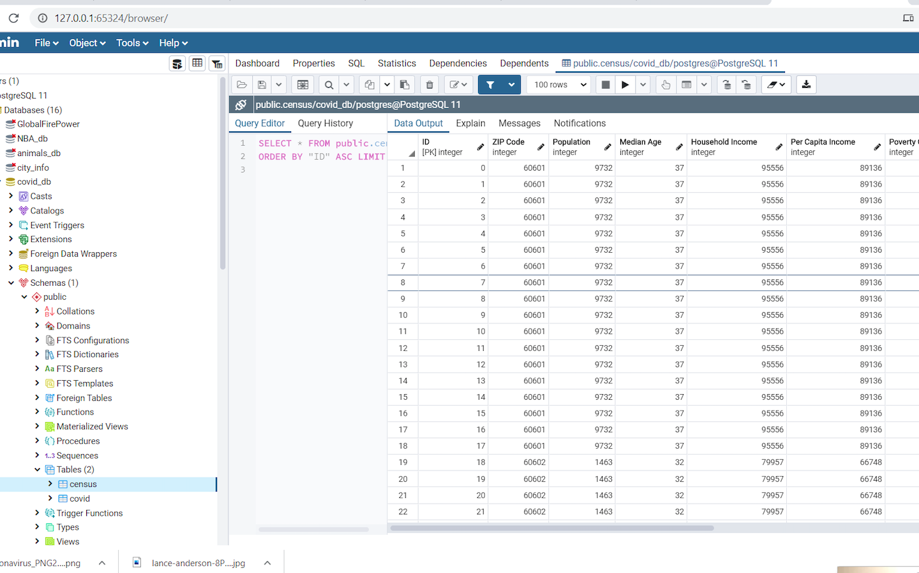
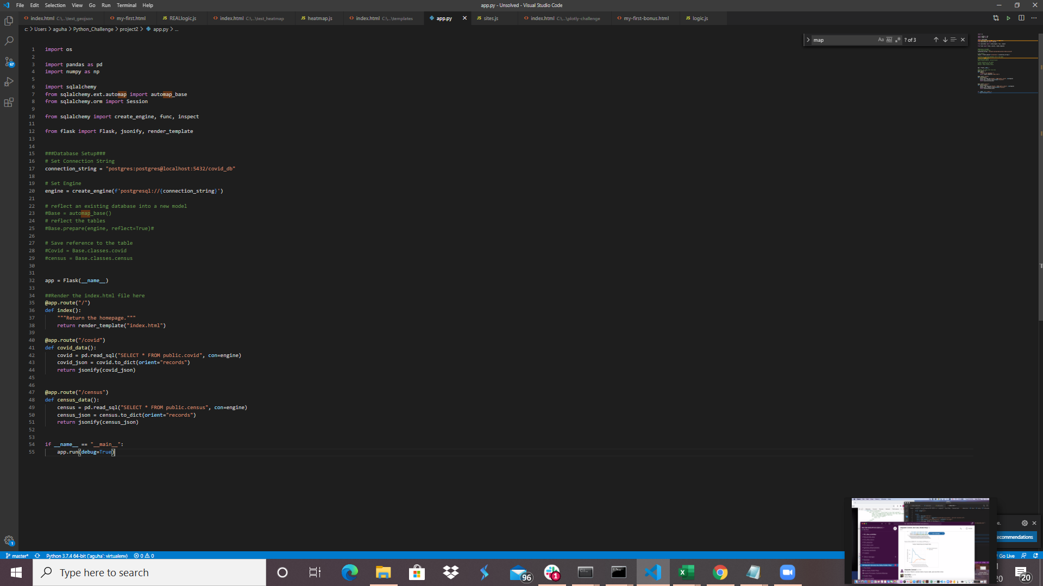
Data Munging/Flask
Notes:
Our covid data is Downloaded in the form of CSVs into a python notebook to complete the data cleanup. Tables were loaded into Postgres SQL. Using flask routes we loaded the database tables and served our final dashboard using Flask.

Slide 5
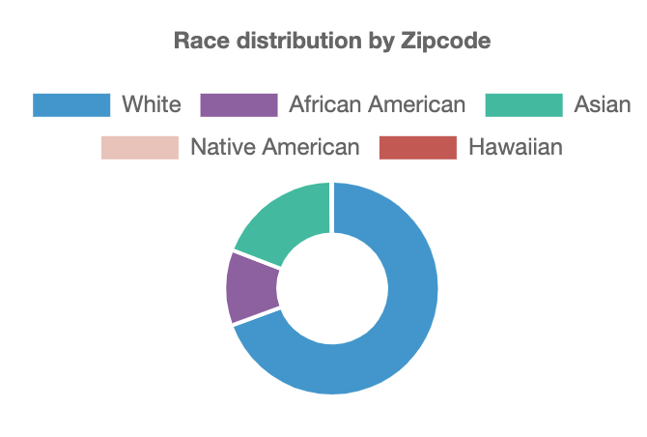
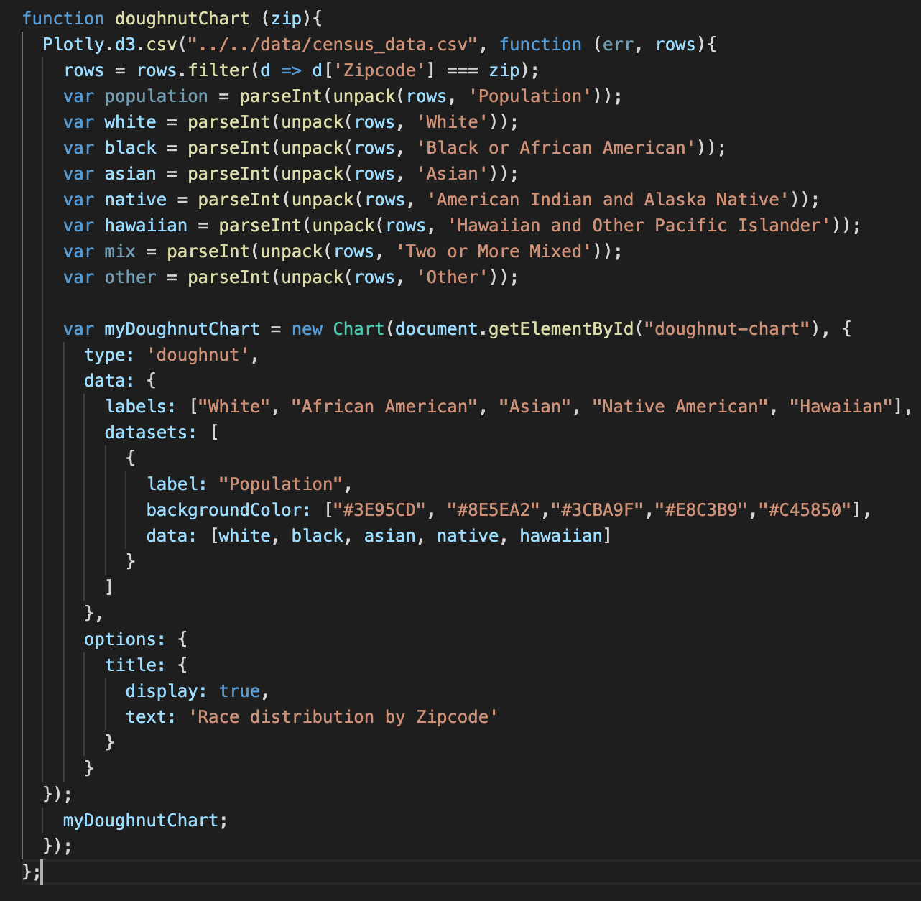
Plotly & Chart.js (Javascript library)
Notes:
For the figures generated by plotly, the data was read by flask route. D3 was used to call the data. Through basic plotly functions, the Bar chart and Line chart both represent Covid’s impact since March and how it has affected Chicago’s neighborhoods. The Pie chart was created by chart.js which is a javascript library and that represents demographic information by zip code.

Slide 6
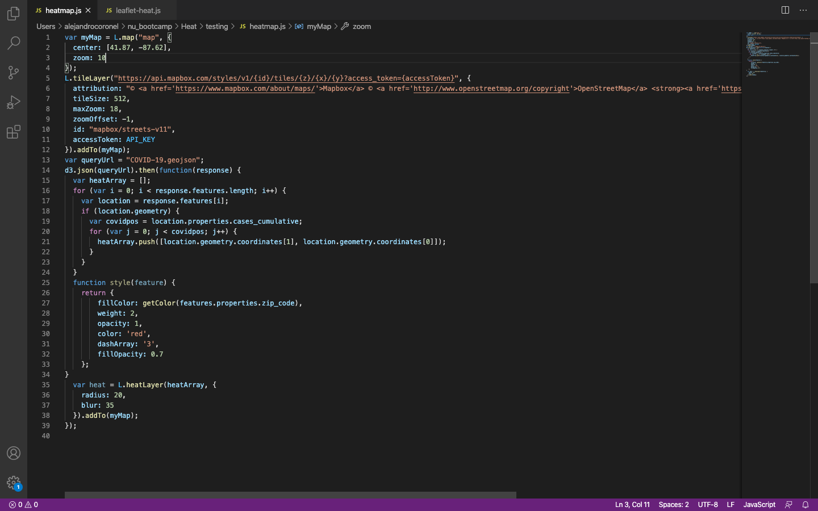
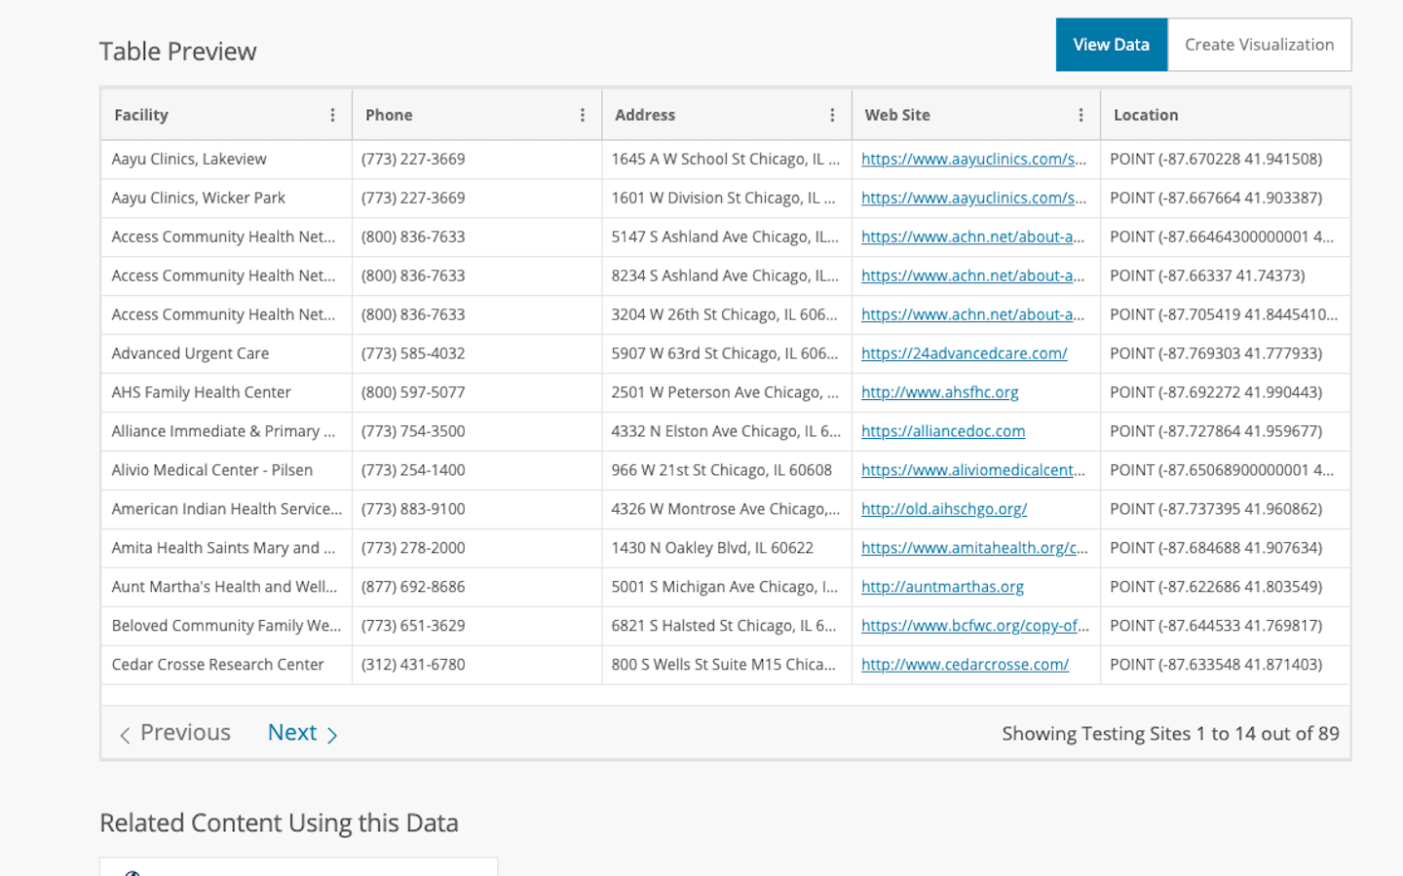
Leaflet
Covid-19 Cases Data: https://data.cityofchicago.org/Health-Human-Services/COVID-19-Cases-Tests-and-Deaths-by-ZIP-Code/yhhz-zm2v
Testing sites Data: https://data.cityofchicago.org/Health-Human-Services/COVID-19-Testing-Sites-Map/j2wj-wjrp
Notes:
Our interactive maps are created by leaflet. D3 was used to call both data sets which were in the form of geojsons. We created two maps, which best fit to represent these data sets to the finalized dashboard.
At this time now, Anu and Yalu will take the stage and show you all our dashboard. Enjoy!

Slide 7
Dashboard Demo

Slide 8
More time! What would we do?
Improve Bootstrap design and CSS functionality using the grid
Create visualizations centered on neighborhoods with highest Covid-19 rates.
Use current Covid-19 live data (pull recent data).
Expand data beyond Chicago and into surrounding Suburbs. Midwest Area?
Deploy dashboard using Heroku.
Notes:
To conclude, at this time we are happy to take questions and zip code requests if any of you are curious to see your local covid-19 statistics. Thank you!

Slide 9
Thank You! Any questions?

